Slide 1

VIP-CSL PRESENTATION Mohit Sharma MASc. Electrical Engineering (Second Last term) Aug 05, 2022 EDA, Hardware Design, VLSI
Notes:
Good afternoon everyone.
Welcome – proposal seminar on the topic of DSE of PD of 12nm low power AI processor.
Intro: I am Mohit Sharma, a master’s in applied science student enrolled in thesis based electrical engg. Course.
I would like to thank my committee members

Slide 2
Agenda
Placement Organization
VIP-CSL Role
Motivation
Skills learned and exercised
STAR Interview Answer
Future Plans

Slide 3

Placement
Organization
Seniors
Youth
Migrant Workers
Several programs including
community outreach, health and wellness, disaster relief, Migrant Women Farm Workers Initiative
International Groups

Slide 4
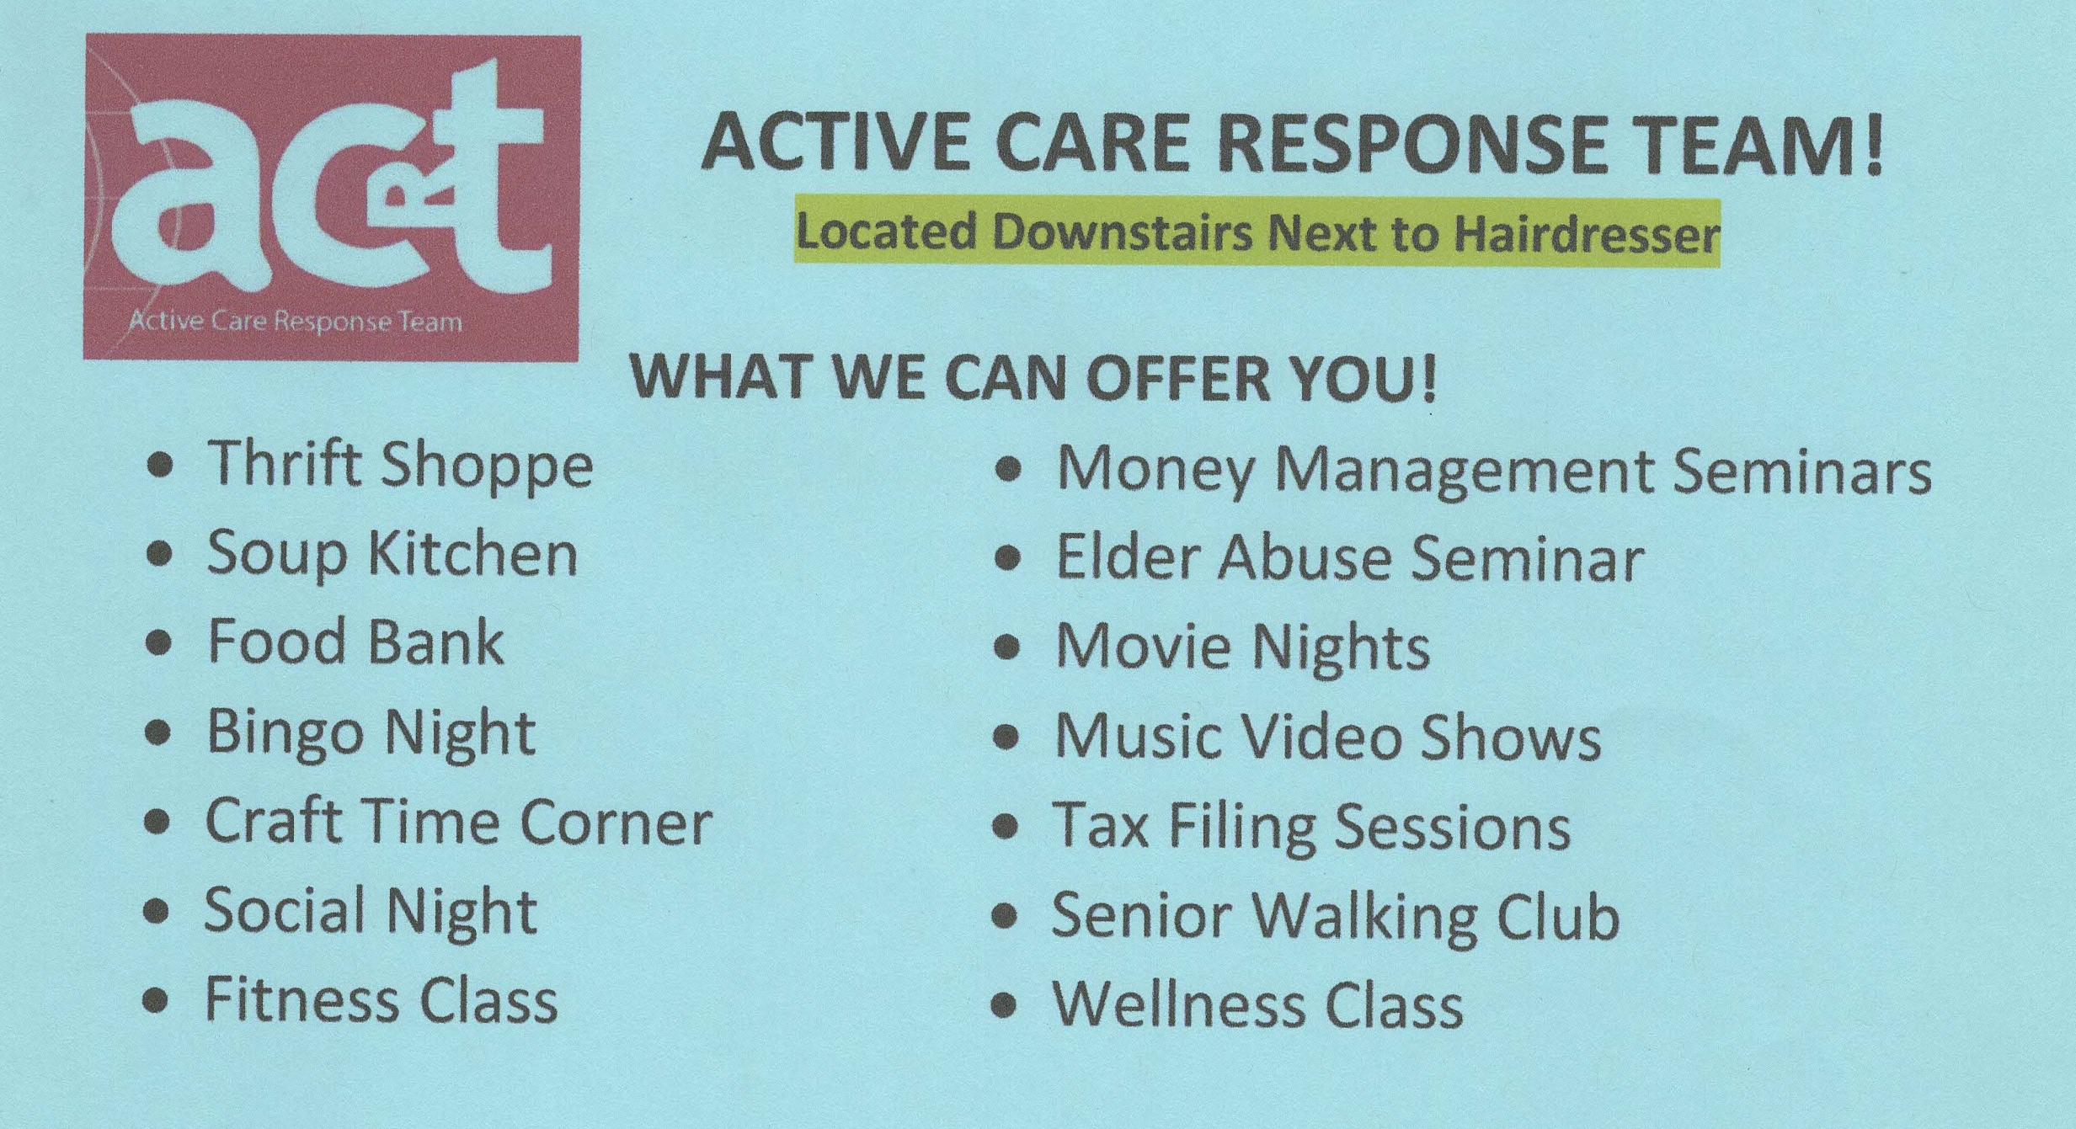

Slide 5
VIP-CSL Role
Managing Thrift Store
Declutter of storage area
Have Fun!!!
Designing posters for various programs
Proposal research and writing

Slide 6

Thrift
Store
Seniors
Proposal writing
Volunteer to support these roles

Slide 7
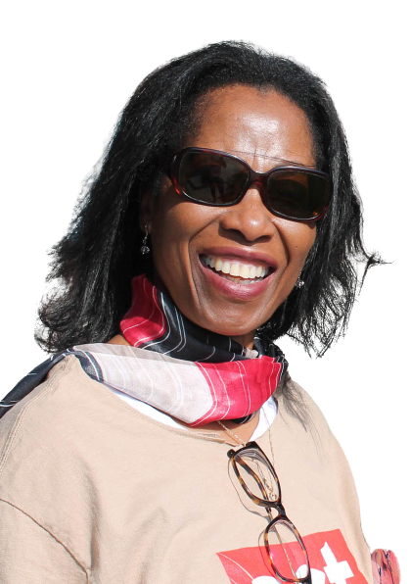

Lizzy Walker
Stuart
Nina
Irene
Sandie
Bill

Slide 8

Motivation
Time management
Research
Communication
Leadership
Computer
Skills
Problem Solving
Adaptability
Writing
Project planning and manage-
ment
Teamwork
Canadian real-world job Experience
Feel good by contributing to society

Slide 9
Skills exercised
Computer Skills
Teamwork
Research
Problem Solving
Project planning & management
Adaptability
Communication
Time management
Leadership
Writing

Slide 10

STAR Interview Answer
Tell me about a time when you relied on your communication skills to help complete a challenging task during your VIP-CSL placement.
Give me an example from your VIP-CSL experience that will convince me you have excellent time management skills.
If you get this job, you will need to research and learn swiftly on a regular basis. How have you demonstrated your ability to do this in your VIP-CSL experience?

Slide 11
Future Plans
Study the past
if you would
define the future
- Confucius

Slide 12
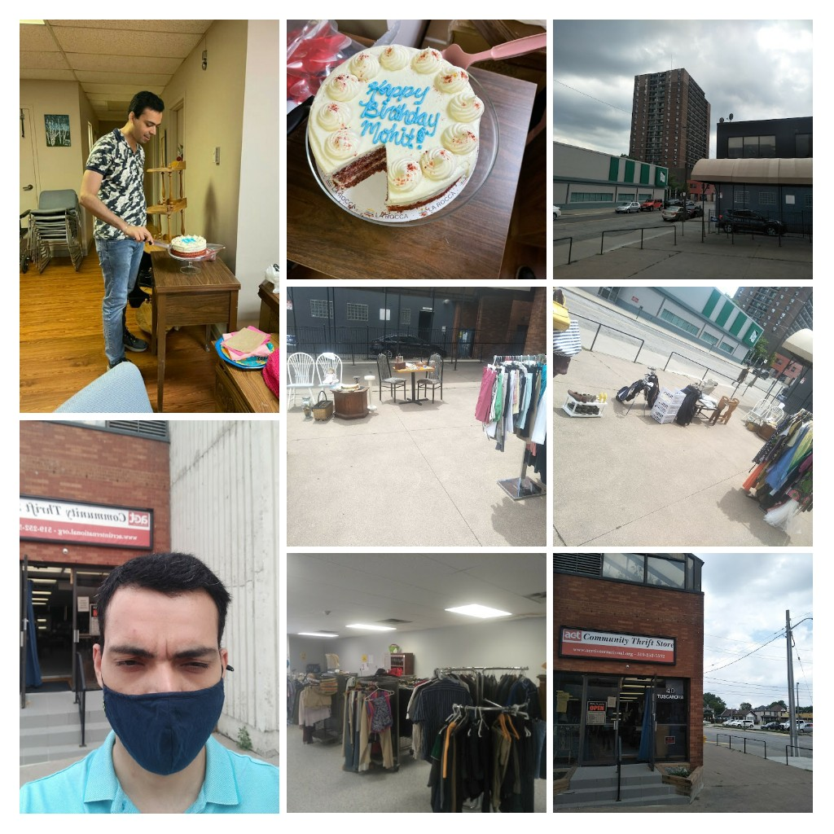
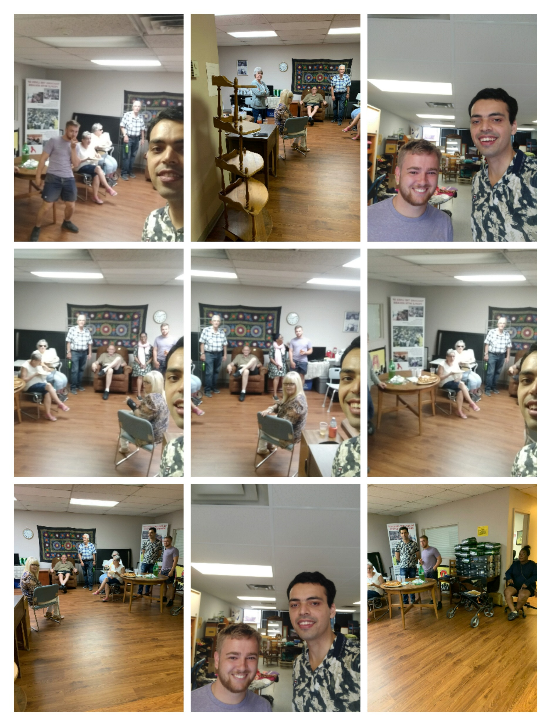

Slide 13
Thank You

